Slide 1
TO-DO Lıst Applıcatıon wıth Python by Batuhan Kurt -ICS4U

Slide 2
Table of COntents
1- Purpose of the application
2- Technologies Used
3- Features
4- Code Explanation
5- How to Download
6- Conclusion

Slide 3
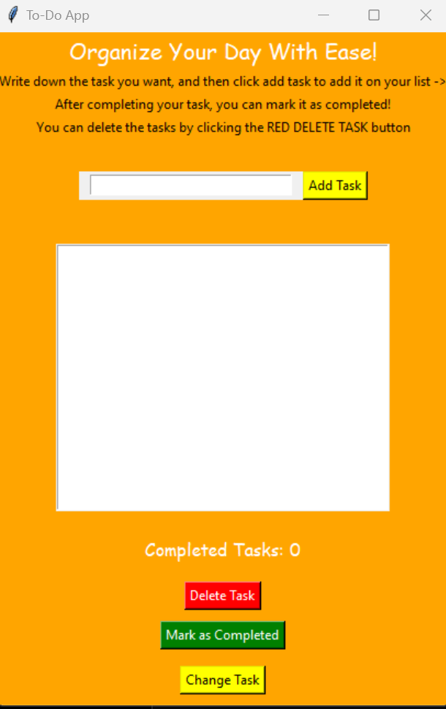
1- Overview
We all have a ton of to-do tasks in our days that often turn into complex piles that can't be sorted through.
The To-Do List app is designed to help users efficiently manage their daily tasks.
It allows users to add tasks, update, delete and mark tasks as completed.
It also provides motivating feedback to the user by saving completed tasks.
With the to-do list application, you can simplify your days and turn them into a game!

Slide 4


2- Technologies used
The To-Do List Application is developed using Python, a high-level programming language known for its readability and simplicity.
The graphical user interface (GUI) of the application is built with Tkinter, a standard GUI library in Python.
Tkinter provides a framework to create windows, dialogs, buttons, and other GUI components with ease.
Additionally, the application uses Tkinter's messagebox module to display warning messages,that validated and enhancing the overall usability of the app.

Slide 5




3- Features
Text box for Inputs
The program consists of a main window with an input widget for task entry.
A list box for displaying tasks and buttons for adding, updating, deleting and marking tasks as completed.
The main modules include the GUI setup, task management methods:
(add, update, delete, mark as complete) and a method to refresh the list box.
List Box to Display List of Tasks
UI Buttons

Slide 6
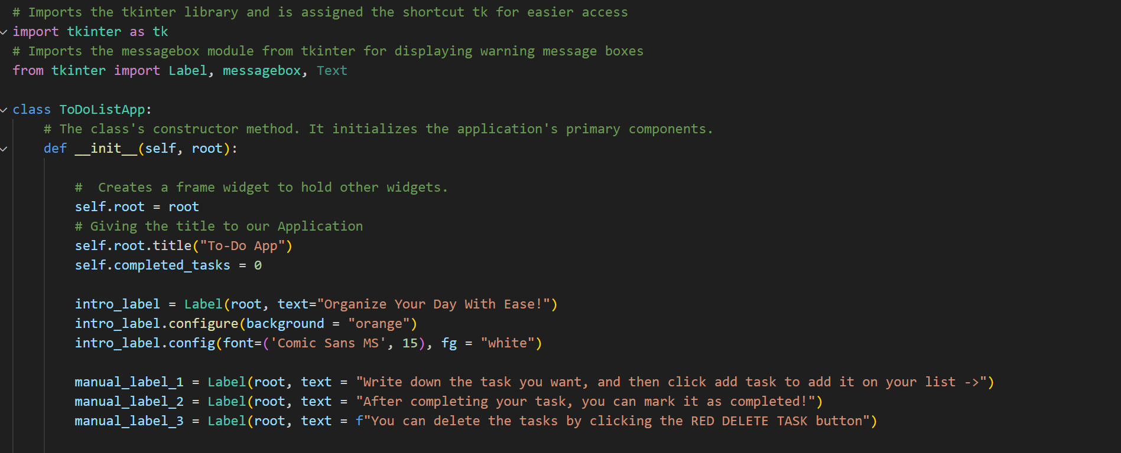
4- Code explanation
#1: Creating the Canvas

Slide 7
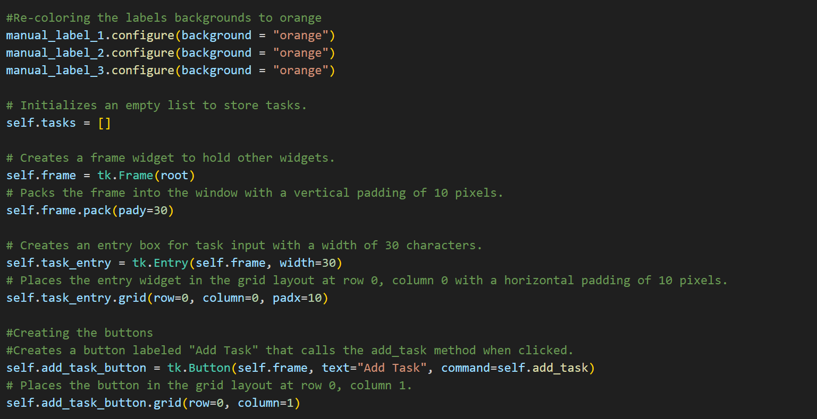
4- Code explanation
#2: Coloring the Labels

Slide 8
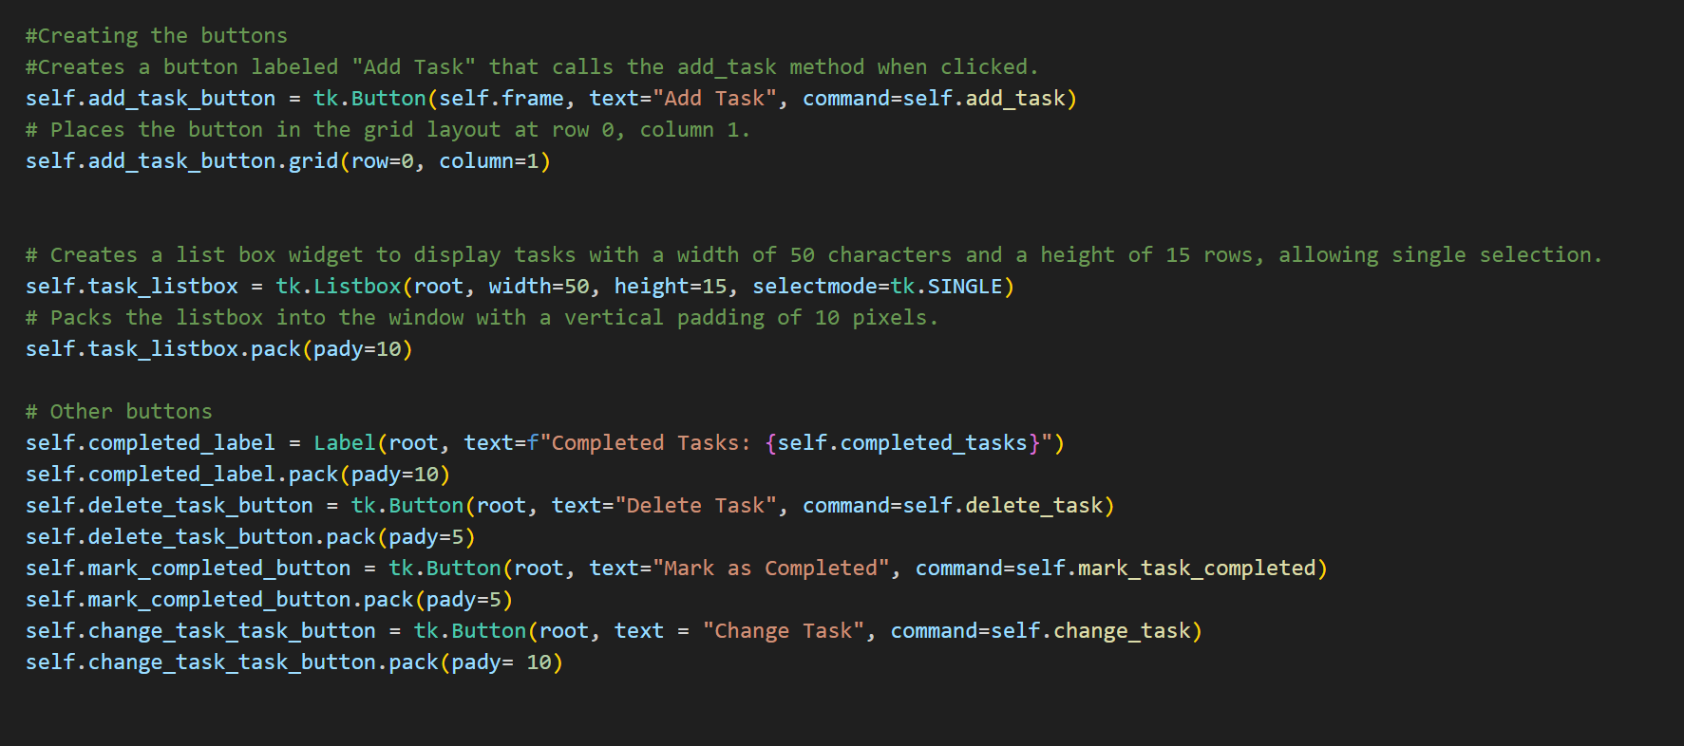
4- Code explanation
#3: Adding Buttons

Slide 9
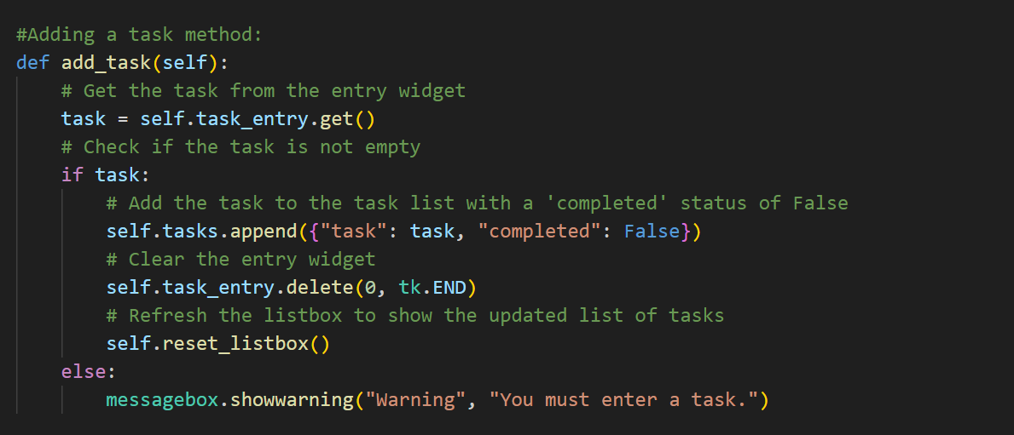
4- Code explanation
#1: Add Task Method:
Function: add_task()
Ensures the task entry is not empty.
Adds the task to the list and updates the listbox.
Shows a warning if the entry is empty.

Slide 10
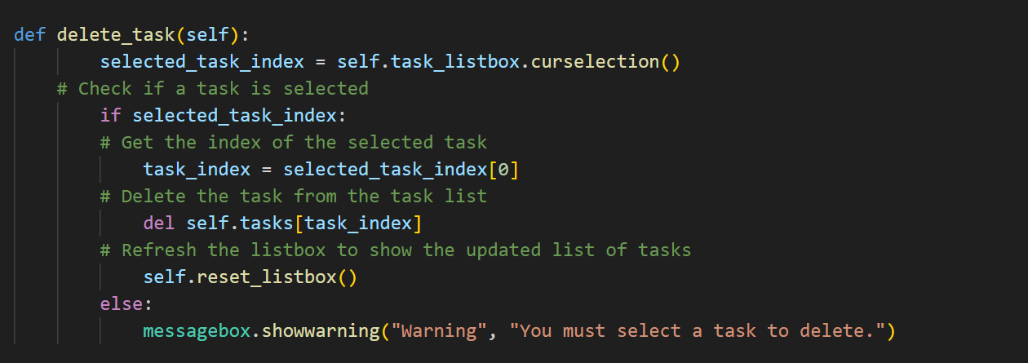
4- Code explanation
#2: Delete Task Method:
Function: delete_task()
Deletes the selected task from the list.
Shows a warning if no task is selected.

Slide 11
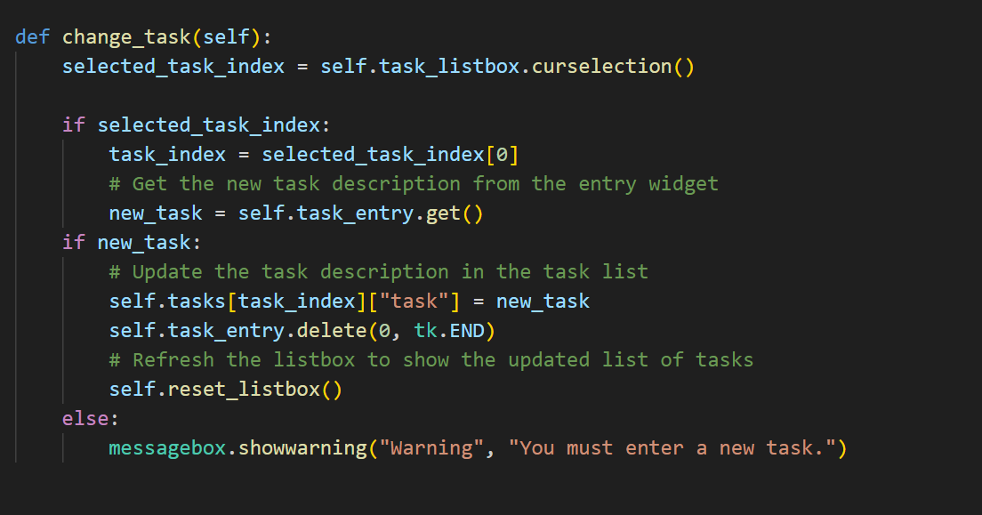
4- Code explanation
#3: Change the Task method:
Function: delete_task()
Deletes the selected task from the list.
Shows a warning if no task is selected.

Slide 12
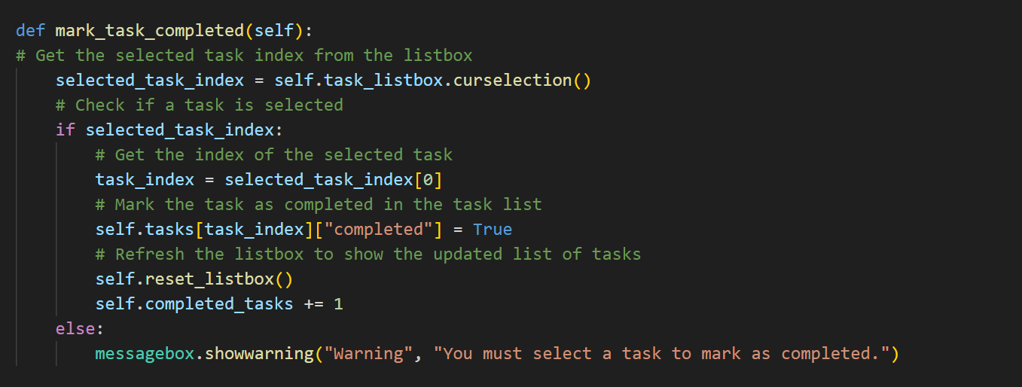
4- Code explanation
#4: Mark Task as ompleted
Function: mark_task_completed()
Marks the selected task as completed. Updates the completed tasks count.
Shows a warning if no task is selected.

Slide 13
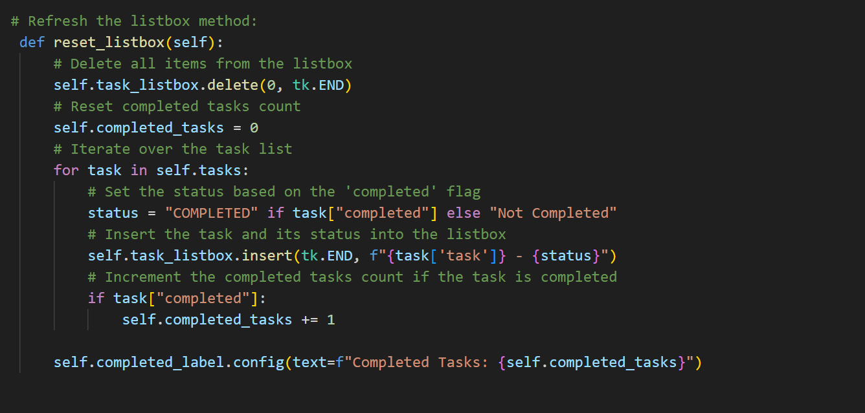
4- Code explanation
#5: Refresh List
Function: mark_task_completed()
Marks the selected task as completed. Updates the completed tasks count.
Shows a warning if no task is selected.

Slide 14


5- How to download
Go to -> https://github.com/BATU-25/To-Do-App
Click on the Green Code Icon to find reach the download link
You will have the
To-Do List Application
Source Code to check the Code yourself
Find the Presentation if you would like to read again

Slide 15
Thanks For Listening !

